Slide 1

CRACKING HASHES USING HASHCAT

Slide 2
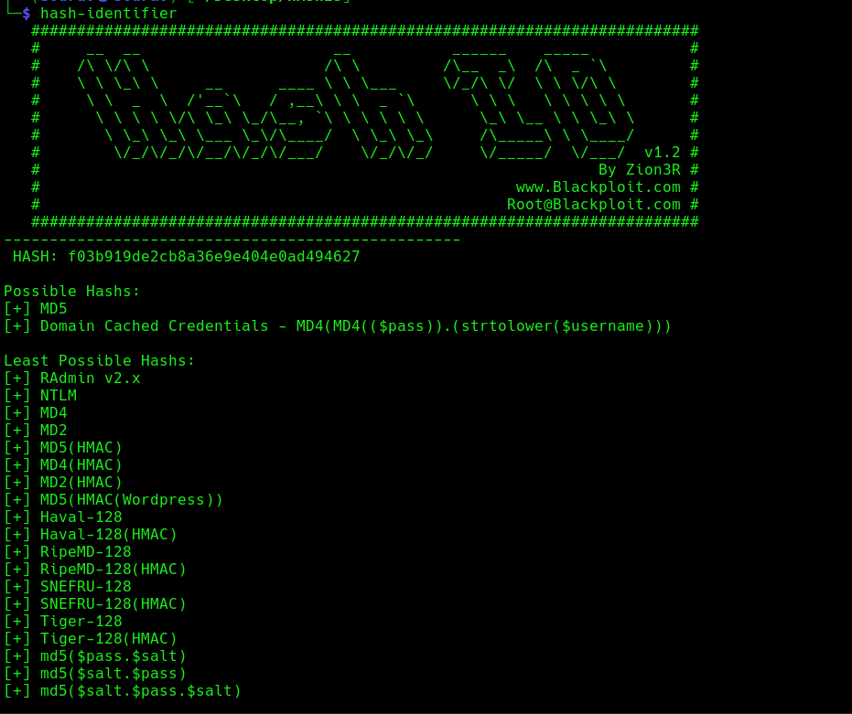

STEP 1
Same as before cracking the hash type we need to find the hash type or format using hash-identifier, you can also use tools from online
STEP 2
Using hashcat and using the MD5 module the famous rockyou.txt wordlist to crack the hash and get the password

Slide 3
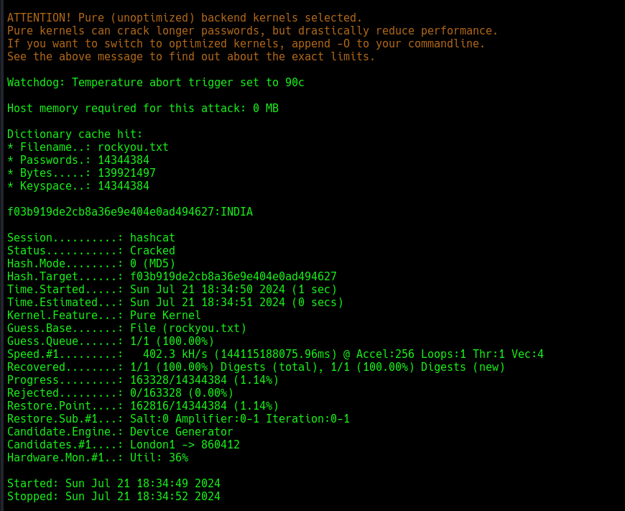
STEP 3
The hashcat has been launched and its cracking the password. You can checkout the status. If you get exhausted it probably means the wordlist or the hash-type isn't appropriate so also try the least possible hashes mentioned by hashcat

